Slide 1
Algorithms
1-<number>

Slide 2
Contents
Algorithms
Complexity
Problem Solving
Computational Thinking
1-<number>

Slide 3
What is an Algorithm
A step-by-step specification of a method to solve a problem within a finite amount of time
[Alternative] A precise set of rules specifying how to solve a particular problem
1-<number>

Slide 4
Express Algorithms
High-level:
  Assume the first item is largest.
  Look at each of the remaining items in the list and if it is larger than the largest item so far, make a note of it.
  The last noted item is the largest in the list when the process is complete.
1-<number>

Slide 5
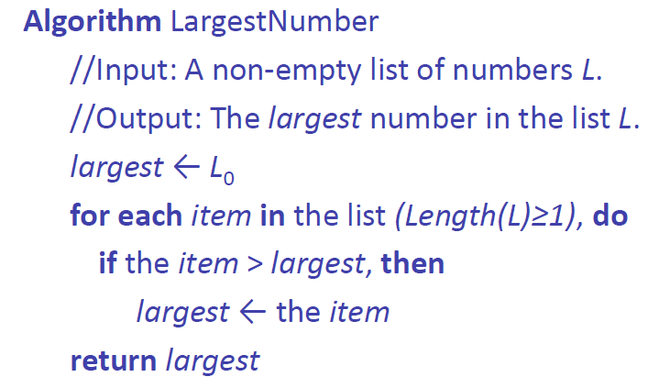
Express Algorithms
Formal -level:
1-<number>

Slide 6
Express Algorithms
Expressed at a level of abstraction that allows:
  A focus on essential aspects only
  Machine and language independence
  Rigorous scientific/mathematical analysis
1-<number>

Slide 7
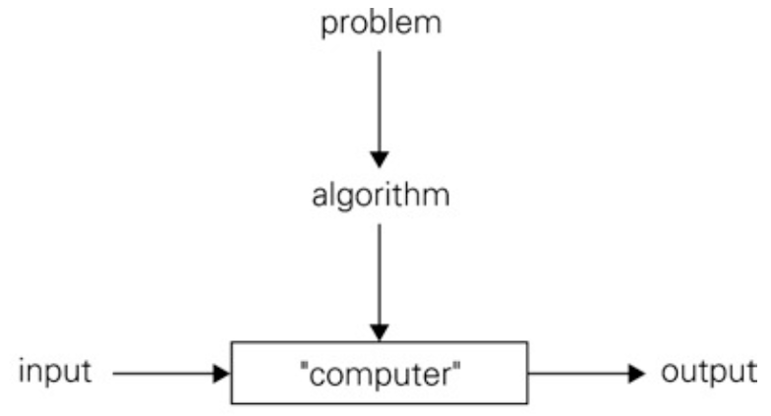
Algorithm: Definition
An Algorithm is a sequence of unambiguous instructions for solving a problem, i.e., for obtaining a required output for any legitimate input in a finite time
1-<number>

Slide 8
Properties of the definition
Each step must be unambiguous
Range of allowable inputs must be specified
The same algorithm can be represented in different ways
There can be several algorithms for the same problem
  They can differ dramatically in concept, speed, and space requirements
1-<number>

Slide 9
Common Features
Descriptions of algorithms often involve:
  Sequential and Parallel Execution
  Conditionals and Decision Making
  Looping and Repetition
  Assumed Details
  etc…
There are corresponding features in many programming languages.
1-<number>

Slide 10
How Good is an Algorithm?
Given a particular algorithm, we might ask:
  Does it solve the original problem?
  How fast is it?
  How much space does it require?
  Are there “better” ways to solve this problem?
1-<number>

Slide 11
First Approach: Experiment!
Implement the algorithm
Run it on some test data
1-<number>

Slide 12
First Approach: Experiment!
Implement the algorithm
Run it on some test data
But if we can’t test all possible inputs
  We might miss cases where the algorithm fails
  We might miss cases where performance is particularly good (or bad)
  Results will depend on implementation details
Works well in some, but not all cases?
1-<number>

Slide 13
Second Approach: Analyze!
Study the algorithm in general terms
Try to predict general trends in behavior
  Correctness: Does it do the “right thing”?
  Performance:
    How long does it take?
    How much memory does it use?
1-<number>

Slide 14
Performance
Execution time depends on:
  The size of the input data
  The input data itself
  The machine and implementation
What exactly do we want to measure?
  Clock ticks?
  Wall time?
  Number of machine instructions?
  Number of primitive operations?
  All of the above
  It doesn’t really matter
1-<number>

Slide 15
Complexity
Example
  for i: 0 → n
  for j: 0 → n
  Do something
Number of operations: f(n) = C₁ * n(n+1)/2 ~ C * n²
1-<number>

Slide 16
Complexity
Example
  for i: 0 → n
  for j: 0 → n
  Do something
Number of operations: f(n) = C₁ * n(n+1)/2 ~ C * n²
Example
  for i: 0 → n
  Do something
Number of operations: g(n) = K * n
1-<number>

Slide 17
Algorithm: Example
http://www.spoj.com/EIUDSA14/problems/EIUARRAY: Find the largest number in an array
High-level
  Assume the first item is largest.
  Look at each of the remaining items in the list and if it is larger than the largest item so far, make a note of it.
  The last noted item is the largest in the list when the process is complete.
Formal-level
1-<number>

Slide 18
Algorithm: Example
http://www.spoj.com/EIUDSA14/problems/EIUARRAY: largest number in an array
High-level
Formal-level
1-<number>

Slide 19
Algorithm: Example
http://www.spoj.com/EIUDSA14/problems/EIUARRAY: Find the largest number in an array
Generalize?
  Find the largest number in an array that satisfies the following condition
1-<number>

Slide 20
Algorithm: Example
http://www.spoj.com/EIUDSA14/problems/EIUARRAY: Find the largest number in an array
Generalize?
  Find the largest number in an array that satisfies the following conditions
    The number is odd
    The number is divisible by 7
    The number is greater than K and less than N
1-<number>

Slide 21
Algorithm: Example
http://www.spoj.com/EIUDSA14/problems/EIUARRAY: Find the largest number in an array
High-level
  Assume the first item that satisfies required conditions is largest.
  Look at each of the remaining items in the list and if it is satisfies all required conditions and it is larger than the largest item so far, make a note of it.
  The last noted item is the largest in the list when the process is complete.
1-<number>

Slide 22
Algorithm: Example
http://www.spoj.com/EIUDSA14/problems/EIUARRAY: Find the largest number in an array
Generalize?
  Find the largest number in an array that satisfies the following condition
More generalize
  Find the number in an array that function g(x) produce the largest value with parameter number
1-<number>

Slide 23
Algorithm: Example
http://www.spoj.com/EIUDSA14/problems/EIUARRAY: Find the number in an array that make the largest value of a function g(x)
High-level
  Calculate g(x) with parameter is the first item, assume it is largest.
  Look at each of the remaining items in the list, calculate g(x) with parameter item, if it is larger than the largest item so far, make a note of it.
  The last noted item is the largest in the list when the process is complete.
1-<number>

Slide 24
Algorithm LargestValue
// Input: Array of number
  // Output: The largest value of function g(x) with parameter is array number
  largest ← g(array[0])
  for each number in the array do
  temp ← g(number)
  if temp > largest then
  largest ← temp
  Return largest
1-<number>

Slide 25
Algorithm: Example
http://www.spoj.com/EIUDSA14/problems/EIUARRAY: Sum of an array
High-level
  Assume Sum is 0
  Look at each number in the array, add the number to Sum
  Sum is the result when the process is complete
Formal-level
1-<number>

Slide 26
Algorithm: Example
http://www.spoj.com/EIUDSA14/problems/EIUARRAY: Sum of an array
High-level
Formal-level
  Algorithm SumArray
  //Input: Array of number
    //Output: The sum of all numbers in array
    sum ← 0
    for each number in the array
    sum ← sum + number
    Return sum
1-<number>

Slide 27
Algorithm: Example
http://www.spoj.com/EIUDSA14/problems/EIUARRAY: Average of array number
High-level
  Average is sum of the array divided by the length of the array
  * Reuse SumArray algorithm (Procedural Abstraction)
Formal-level
  Algorithm AverageArray
  //Input: Array of number
    //Output: Average value of all numbers in the array
    Return SumArray(array) / Length(array)
1-<number>

Slide 28
Algorithm: Example
http://www.spoj.com/EIUDSA14/problems/EIUARRAY: Minimum difference between two consecutive numbers in an array
High-level
  Assume MAX_INTEGER is the smallest
  Look at each two consecutive numbers, if their absolute difference value smaller than the smallest so far, make a note of it
  The last noted item is the smallest when the process is complete
Formal-level
1-<number>

Slide 29
Algorithm: Example
http://www.spoj.com/EIUDSA14/problems/EIUARRAY: Minimum difference between two consecutive numbers in an array
High-level
Formal-level
Algorithm MinimumDistance
  //Input: Array of number
  //Output: Minimum difference between two consecutive numbers in an array
  smallest ← MAX_INTEGER
  for i: 0 → length-1 (exclusive) do
  if abs(array[i] – array[i+1]) < smallest then
  smallest = abs(array[i] – array[i+1])
  Return smallest
1-<number>

Slide 30
Algorithm: Example
http://www.spoj.com/EIUDSA14/problems/EIUARRAY: Minimum difference between two consecutive numbers in an array
High-level
Formal-level
MinimumDistance({a_{i} | i=0..n-1})
= SmallestNumber({a_{i}-a_{i-1} | i=1..n-1})
1-<number>

Slide 31
Algorithm: Example
http://www.spoj.com/EIUDSA14/problems/EIUARRAY: Find the largest number in an array
Generalize?
  Find the largest number in an array that satisfies the following condition
  Find the number in an array that function g(x) produce the largest value with parameter number
More generalize
  Find…
1-<number>

Slide 32
Problem Solving
Solving problems is the core of computer science
  Programmers must first understand how a human solves a problem,
  then understand how to translate this "algorithm" into something a computer can do,
  finally how to "write" the specific syntax (required by a computer) to get the job done.
  It is sometimes the case that a machine will solve a problem in a completely different way than a human.
1-<number>

Slide 33
Computational Thinking
Decomposition
Pattern Recognition
Pattern Generalization and Abstraction
Algorithm Design
Ref: http://www.google.com/edu/programs/exploring-computational-thinking/index.html#!what-is-ct
1-<number>

Slide 34
Computational Thinking
Decomposition
  The ability to break down a task into minute details so that we can clearly explain a process to another person or to a computer, or even to just write notes for ourselves.
  Decomposing a problem frequently leads to pattern recognition and generalization, and thus the ability to design an algorithm
Example: http://www.spoj.com/EIUDSA14/problems/EISQUARE
  EISQUARE(n, m, a) = EILINE(n, a) * EILINE(m, a)
1-<number>

Slide 35
Computational Thinking
Decomposition
  The ability to break down a task into minute details so that we can clearly explain a process to another person or to a computer, or even to just write notes for ourselves.
  Decomposing a problem frequently leads to pattern recognition and generalization, and thus the ability to design an algorithm
Example: http://www.spoj.com/EIUDSA14/problems/EIUPARK/
  PARK(x1, y1, x2, y2, x3, y3)
  = PROJECT(x1, x2, x3) ^ PROJECT(y1, y2, y3)
1-<number>

Slide 36
Computational Thinking
Pattern Recognition
  The ability to notice similarities or common differences that will help us make predictions or lead us to shortcuts.
  Pattern recognition is frequently the basis for solving problems and designing algorithms
Example: http://www.spoj.com/EIUDSA14/problems/EIWIFI
  EIWIFI(n, m) = EISQUARE(n-2, m-2, 3)
1-<number>

Slide 37
Computational Thinking
Pattern Generalization and Abstraction
  The ability to filter out information that is not necessary to solve a certain type of problem and generalize the information that is necessary.
  Pattern generalization and abstraction allows us to represent an idea or a process in general terms (e.g. variables) so that we can use it to solve other problems that are similar in nature
Example:
  MAX…, MIN…
  EIWIFI(n, m, a, b)
  EISQUARE(n, m, a, b)
  EIWIFI(n, m, a, b) = EISQUARE(n-2, m-2, a, b)
  EILANTER({ai: i=0..n-1}) = MAX({|a_{i+1}-a_{i}|:i=1..n-1}U{a₀, L-a_{n-1}})
1-<number>

Slide 38
Computational Thinking
Pattern Generalization and Abstraction
Example:
  ARRAY…
    for (int i = 0; i < array.length; i++){
    for (int i = 0; i < array.length; i++){
      for (int j = i + 1; j < array.length; j++){
    for (int i = 0; i < array.length/2; i++) {
      g(array[i] vs. array[array.length - 1 - i])
  STRING…
1-<number>

Slide 39
Computational Thinking
Algorithm Design
  The ability to develop a step-by-step strategy for solving a problem.
  Algorithm design is often based on the decomposition of a problem and the identification of patterns that help to solve the problem.
  In computer science as well as in mathematics, algorithms are often written abstractly, utilizing variables in place of specific numbers.
1-<number>

Slide 40
Algorithm: Example
http://www.spoj.com/EIUDSA14/problems/EIUPALIN
High-level
Formal-level
1-<number>

Slide 41
Algorithm: Example
http://www.spoj.com/EIUDSA14/problems/EIUCREAM
High-level
Formal-level
1-<number>

Slide 42
static int solution_analysis(int n, int m) {
int ate = n;
while (n >= m) {
int bonus = n / m;
ate += bonus;
n = n - bonus * m + bonus;
}
return ate;
}
1-<number>

Slide 43
static int solution_human_thinking(int n, int m) {
for (int i = 1; i <= n; i++) {
if (i % m == 0) {
n++;
}
}
return n;
}
1-<number>

Slide 44
static int solution_recursion(int n, int m) {
if (n < m) {
return n;
}
return m * (n / m) + solution_recursion(n / m + n % m, m);
}
1-<number>

Slide 45
static int solution_remove_tail_revursive(int n, int m) {
int result = 0;
while (n >= m) {
result += m * (n / m);
n = n / m + n % m;
}
result += n;
return result;
}
1-<number>

Slide 46
static int solution_mathematic(int n, int m) {
return n + (n - 1) / (m - 1);
}
1-<number>

Slide 47
Algorithm: Example
http://www.spoj.com/EIUDSA14/problems/EIUTHU
High-level
Formal-level
1-<number>

Slide 48
Recursion
Continue: 05. Chapter07-Recursion.ppt
1-<number>

Slide 49
Recursion
More examples
  sum(array)
    sum(array, i) = sum(array, i-1) + array[i]
    sum(array) = sum(array, length(array)-1)
    sum([]) = 0
  max(array)
    max(array, i) = max([max(array, i-1), array[i]])
    max(array) = max(array, length(array)-1)
    max([]) = INTEGER_MINVALUE
1-<number>

Slide 50
Recursion
Example: http://www.spoj.com/EIUDSA14/problems/EIUCREAM
High-level
  When Beo ate the maximum number which is the multiply of m ICs (m * [n/m]), Beo will exchange the boxes to get bonus ICs
  Number of IC Beo can eat is the number of ate ICs plus number IC of the process of remain ICs
Formal-level
  F(m, n) = m * [n/m] + F(m, n%m + [n/m]) (n >= m)
  F(m, n) = n (n < m)
Java program
1-<number>

Slide 51
Recursion
EIUCREAM (Java)
static int solution_recursion(int n, int m) {
if (n < m) {
return n;
}
return m * (n / m) + solution_recursion(n / m + n % m, m);
}
1-<number>

